Slide 1

FITNESS CLUB

Slide 2

Presented by:
Abhishek Kumar(Emp id:6146)
Swapnil Deokar(Emp id:6162)
Nayan Gadhari (Emp id:6144) Amit Dash (Emp id:6149) Murali Arandala (Emp id:6145)
Akshat Singhai (Emp id:6157)

Slide 3
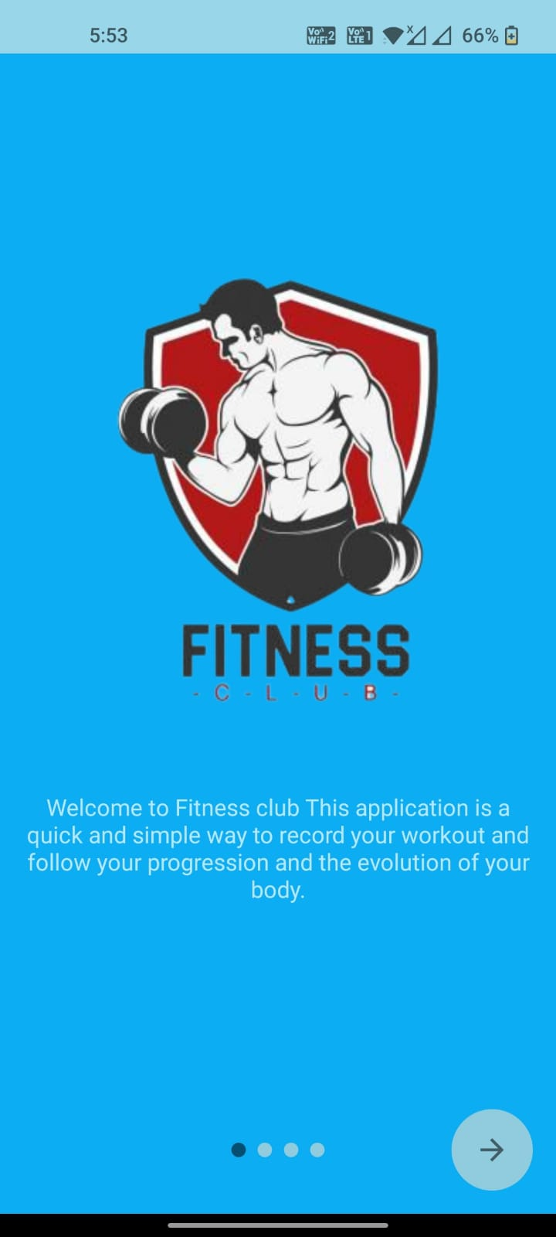
Points to Cover
Introduction
Problem Statement
System design
Technology
Results
Future Enhancement

Slide 4

INTRODUCTION
Our Fitness application facilitates the users to make people fit and health conscious by taking few input and providing a graphics for those inputs.
To build an user friendly application where fitness freak people can do their exercise and workout.
It will support android version from lollipop(5.0) till the latest version.

Slide 5
FEATURES
User Friendly
Can run on any android device
Different types of exercise are there
Attractive UI
Tracking Metrics
Goal Setting
Push Notifications

Slide 6



TECHNOLOGIES
Java
SQLite
Android Studios

Slide 7
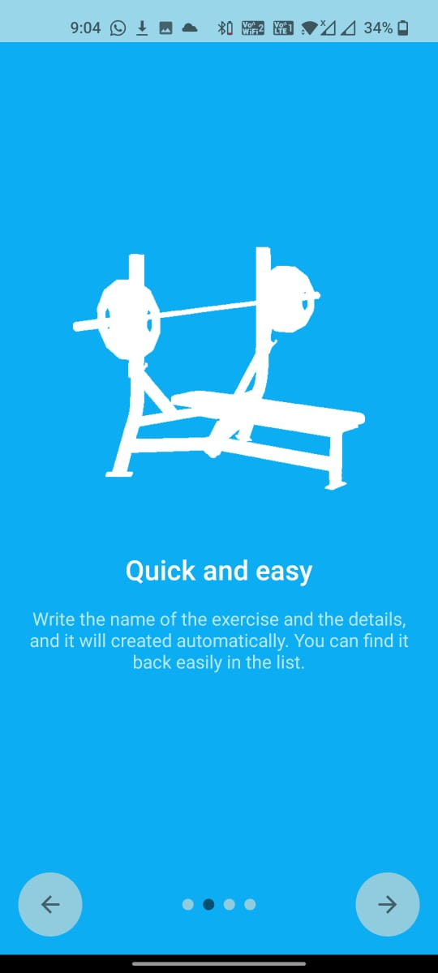
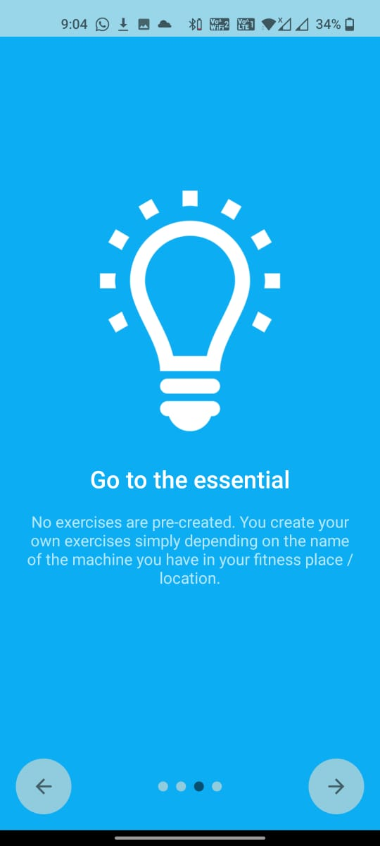
RESULTS

Slide 8
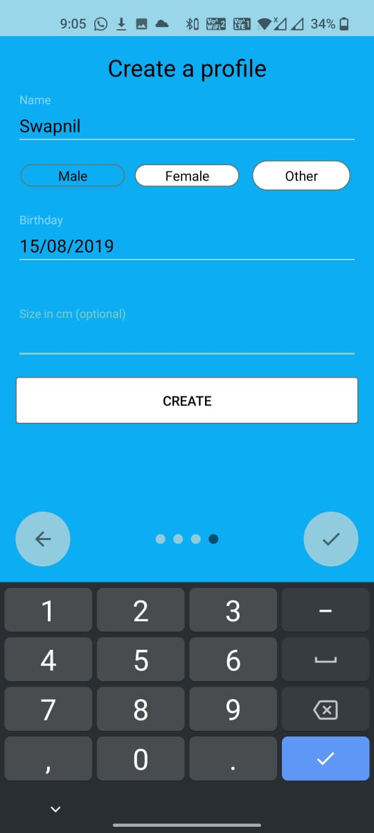
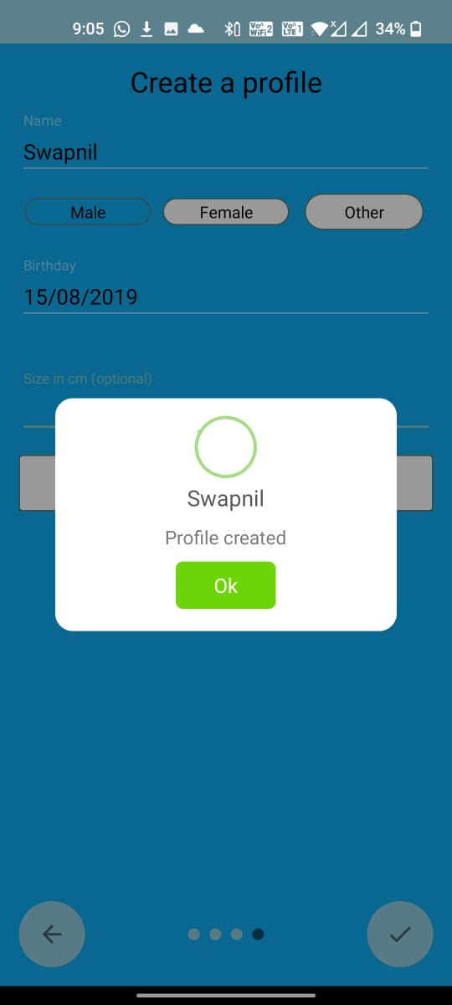
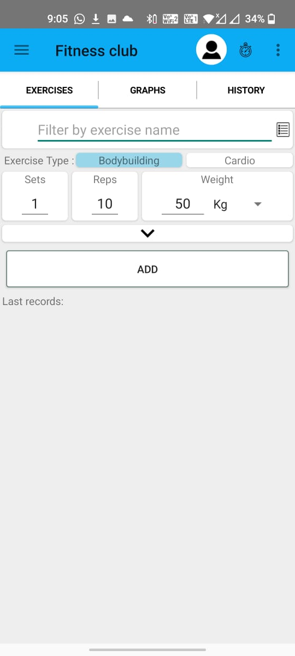

Slide 9
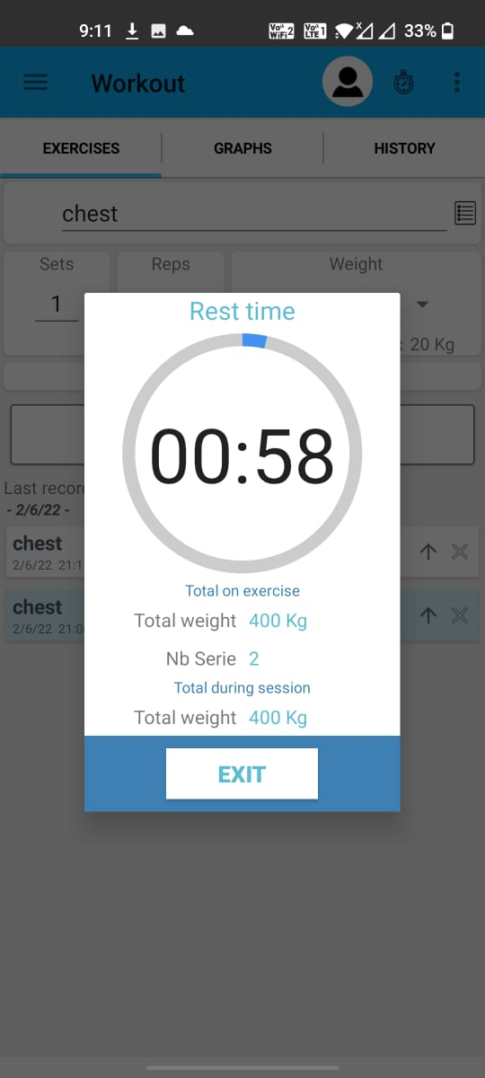
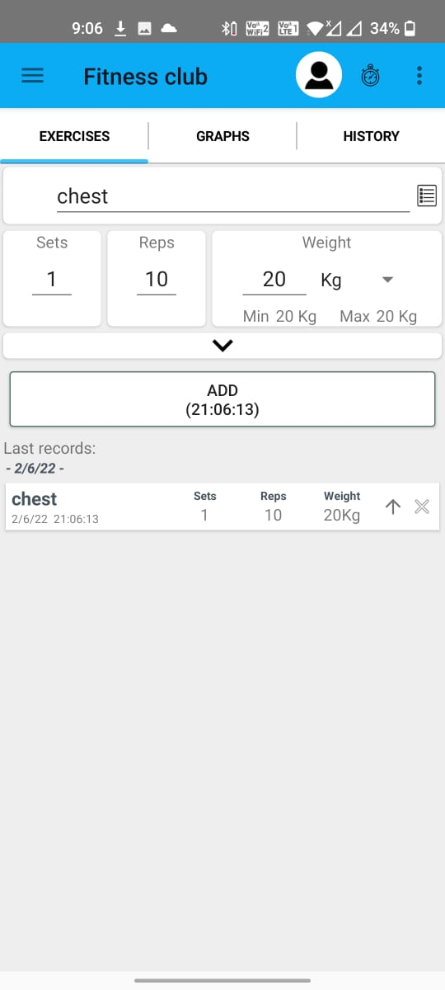
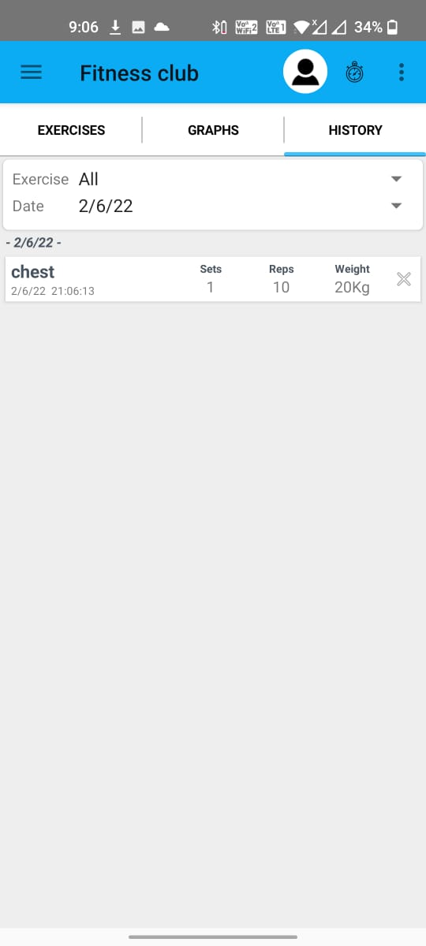

Slide 10
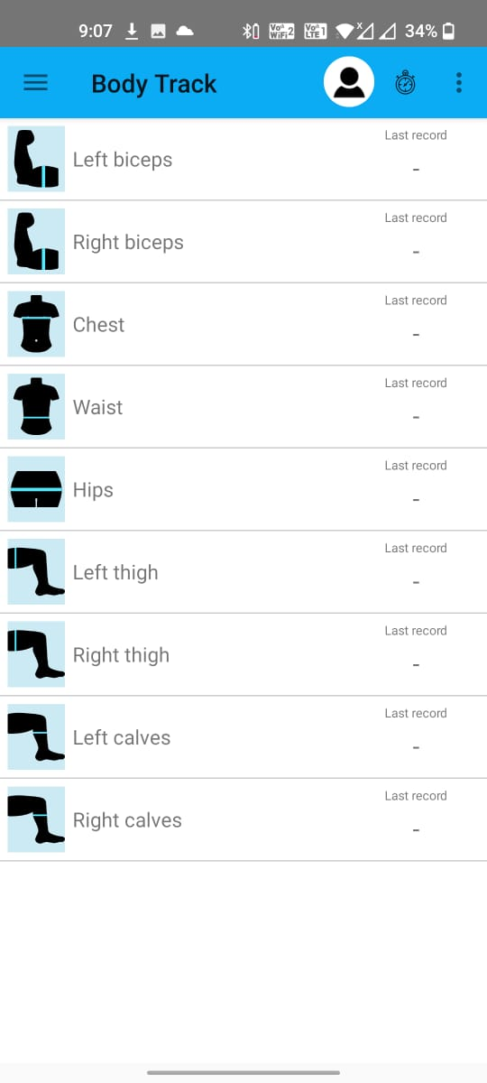
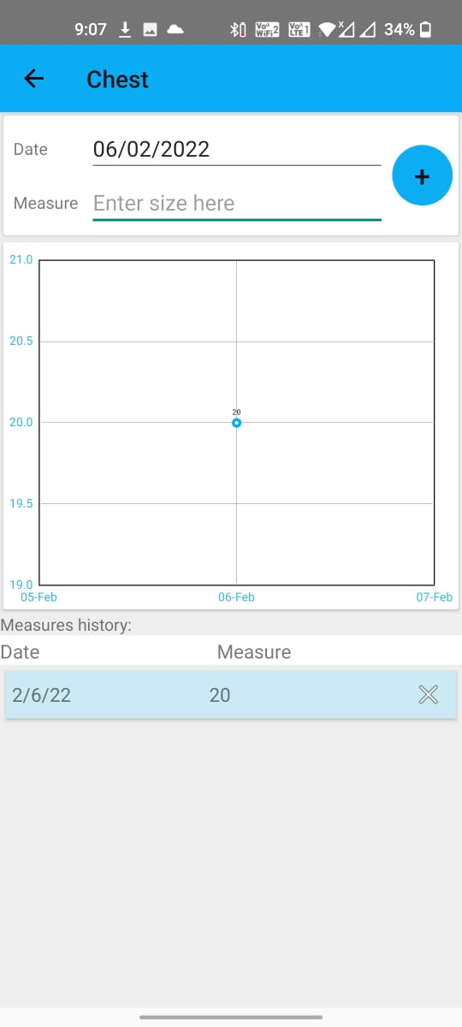
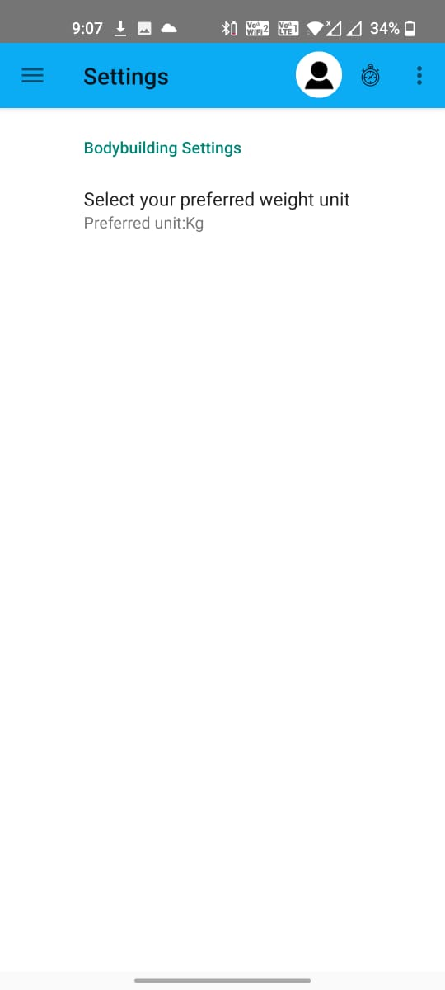

Slide 11
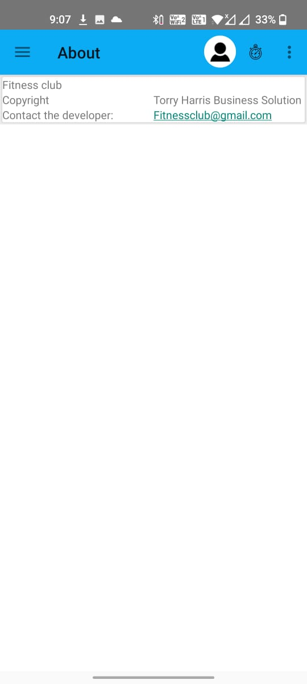
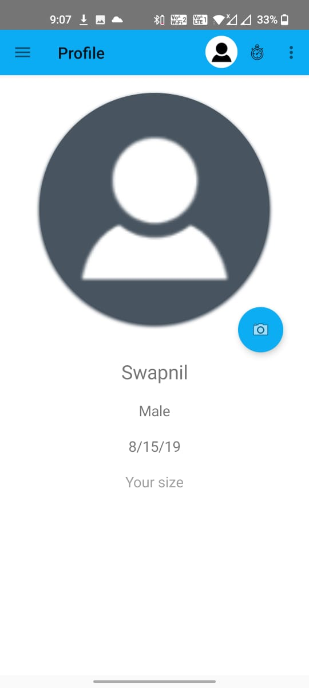
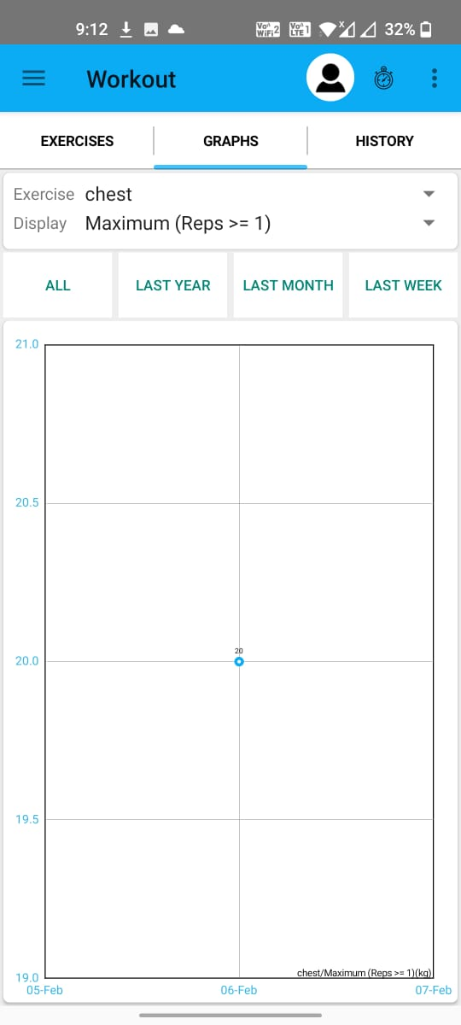

Slide 12

FUTURE ENHANCEMENT
The platform and routes can be host on online service to
to make accessible to users by creating the accurate databases and security structure in railway reservation
Project can be updated in near future as and when requirement for the same arises, as it is very flexible in terms of expansion.
In Future we are planning to add diet plan to suggest user according to there fitness history.
Also we are yet to add BMI(Body mass index) feature in the app.

Slide 13
THANK YOU

